Slide 1
Automated Usher System
By: Gage Bays, Jackson Hyche, Raiden Greene, Whit Brewer

Slide 2
Problem Statement and Feasibility Study

Slide 3
Problem Statement
Having a single person as the security and ticket checking for movie theatres is not very helpful, as the employee could be behind the counter assisting with ticket purchase. Since there is no good security, people could scam there way into movies and not have to pay for tickets, or the right ticket. The turnstile system would allow for a non-manned security and ticket checking system that would allow for more coverage for scamming and more personnel at the counter.

Slide 4
Feasibility Study
Economic:
The turnstile system will not be very cheap, however, it will not be expensive. The purchase of the items required for the turnstile system will cost approximately $25,000 USD. Although this is not a small amount of money, with no need for paying another person to be security, the companies will end in a profit.
Technical:
Implementing the turnstile system for AMC Theatres is technically feasible and involves key considerations. The database for tickets is a simple setup, which can be made in many different ways. The database will hold all ticket sales, dates of purchase, the name of the buyer, etc. and it will check for specific attributes beginning after the scan.

Slide 5
Feasibility Study
Operational:
The operational manpower will increase after the implementation of the system. The turnstile system will allow for more focus on the counter and ticket selling instead of standing around for just ticket scanning.
Legal:
There will be no legal issues with setting up a turnstile system in a movie theatre. The only possible argument for it being a bad idea is emergency exits which there are fire exits in the back off the hallways.
Time:
The most time consuming part of setting up this system would be the process of setting it up in the theatre. Once the item is in the theatre, the rest of the application will be simple and fairly quick.

Slide 6
Brief Review of Requirements Analysis and Specification

Slide 7
Requirements analysis
and specifications
Functional Requirements:
One way, clockwise turning
Minimum 5’5” length, 5’ width, 7’5” height
Will have two doors that allow for push on one side and handle on other
Center bars of the doors can be removed if necessary
Will have an electronic lock that can be unlocked with employee QR code
Handles both paper and digital QR codes
Cannot operate without electricity
Denies entry for tickets until 45 minutes before movie starts

Slide 8
Requirements analysis
and specifications
Operational Requirements:
Should not cost more than $25,000 for initial implementation
Should not cost more than $4,500 a year to operate
Maintenance and Support Requirements:
Glass on panel where QR Scanner is located
Made out of 304 stainless steel
Clean front scanner weekly to ensure clean read
Smooth tile leading into carpet underneath turnstile
Requires maintenance every 3 months
Problems include jamming in which the gate would be open for entry and exit
Fix jamming by unsticking turnstile, pull back, continue pushing forward

Slide 9
Preliminary and Detailed Design

Slide 10
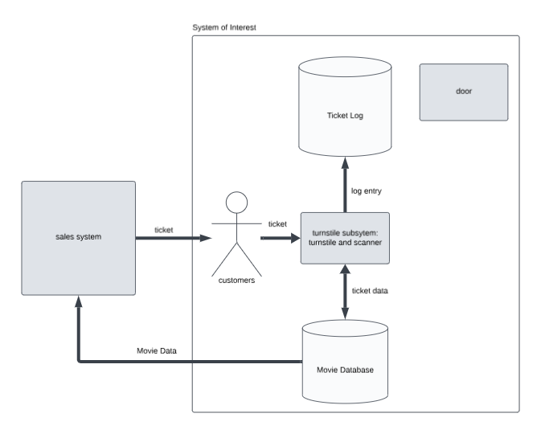
Preliminary design
The system consists of three subsystems which include the Access Control Subsystem, the Data Management Subsystem, and the User Interaction Subsystem.
The Access Control Subsystem verifies ticket validity and triggers the turnstile to allow entry based on integration with the theater's central ticketing system.
The Data Management Subsystem serves as the database for the turnstile, storing records of each entry, timestamp, and ticket type, and integrates with the theater’s main database to validate tickets in real time.
The User Interaction Subsystem enables customers to scan mobile or physical tickets and allows staff to remotely control the turnstile for special cases, like maintenance or emergencies, through an authorized application interface.

Slide 11
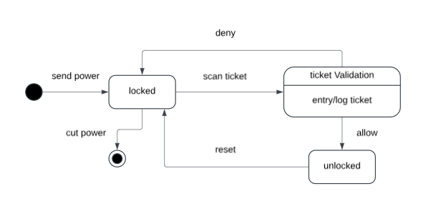
Describe the environment
In the environment of the system, a customer would go about purchasing a ticket through two means, the online app and website or the in-person ticket sales person. The ticket will be printed with a QR code on it, as well as the other ticket attributes produced normally. After purchasing a ticket(s), the customer can either scan the ticket on the QR scanner in the turnstile or end up not using the ticket. If the customer scans the ticket on the QR scanner, the scanner will send ticket data to the movie database for the count of ticket use and active persons in a theater. The scan will also log the entry for that specific ticket and not allow that ticket to be scanned in anymore, as only one person can use a ticket.
Next, the customer can either walk through the turnstile and push through the circle or pull it, in which case nothing would happen as turnstiles only move counter-clockwise. Once the customer has scanned the ticket(s) and walked through, the database will remove that ticket from itself, as it has been used and doesn’t exist anymore, and the turnstile and QR scanner will reset themselves to the waiting stage for the next scan. The door on the side of the turnstile will act as an exit point for the movie theaters and also be used as an entrance for handicapped patrons or another entrance if needed. The inside of the door will have a simple push-to-open piece attached to it so anybody is able to open the door.
On the outside, there will be a small validation scanner on the door for employee ids so the employees don’t have to go through the turnstile every time they wish to get to the back. Since the employees also need to have a location for trash boats to enter and exit, this door will also serve as that as well. The very last thing that happens in the system’s environment is the movie database logging another purchased ticket for a certain movie and logging it into the system.

Slide 12
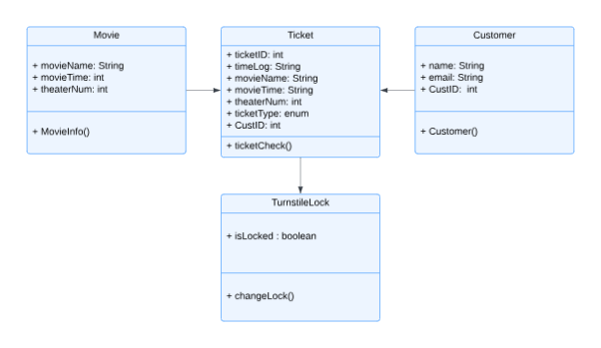
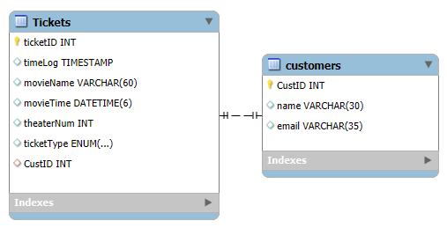
Database design
The design of the database is for ticket logging.
The Tickets table is to have identifying information on the ticket. Mainly for making sure that tickets are not being used multiple times in the turnstile.
The customers table is to attach customer information to the ticket, if available. Physical tickets paid in cash would have no way of identify who has those tickets, while digital tickets would be attached to an account the user would have.

Slide 13
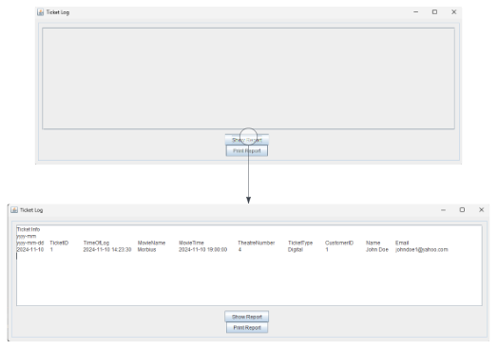
UI Design
The UI is for the report screens of the ticket log.
The UI is extremely simple as the only things that is shown is logging data.
The ability to print will be available.

Slide 14
Project Management

Slide 15
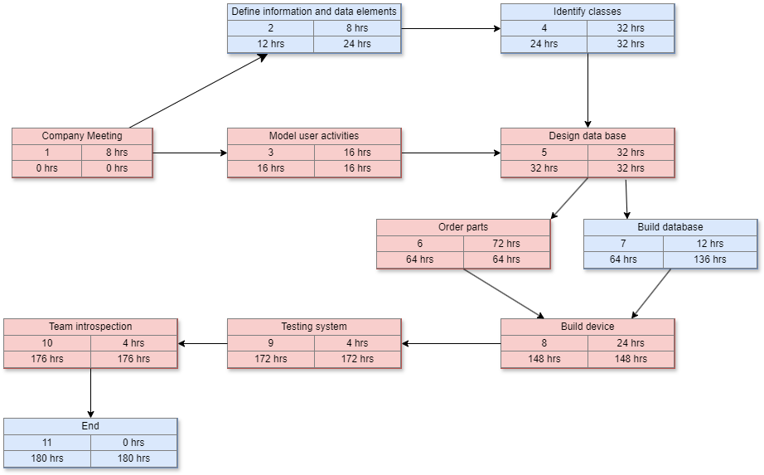
PERT/CPM chart

Slide 16
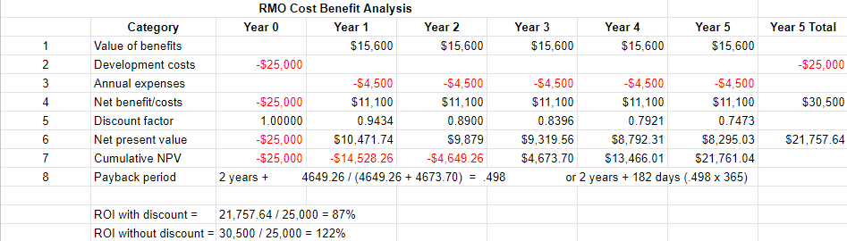
Net present Value Chart
This chart shows the NPV, Payback period, and the Return on Investment.

Slide 17
Prototype

Slide 18
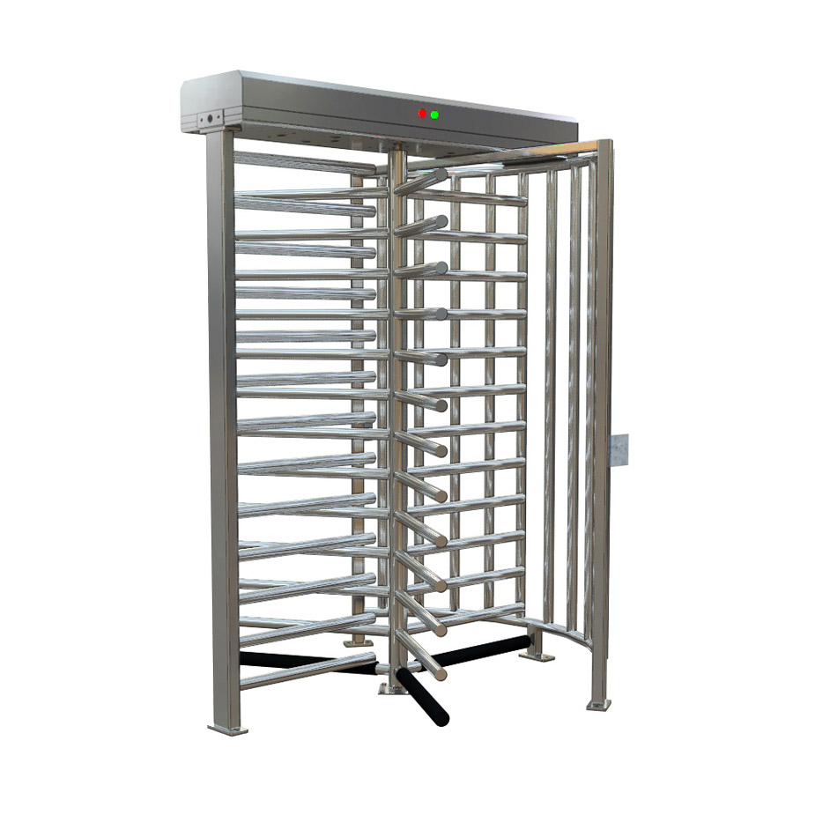
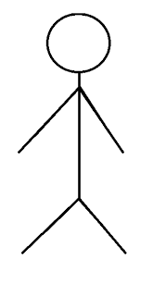
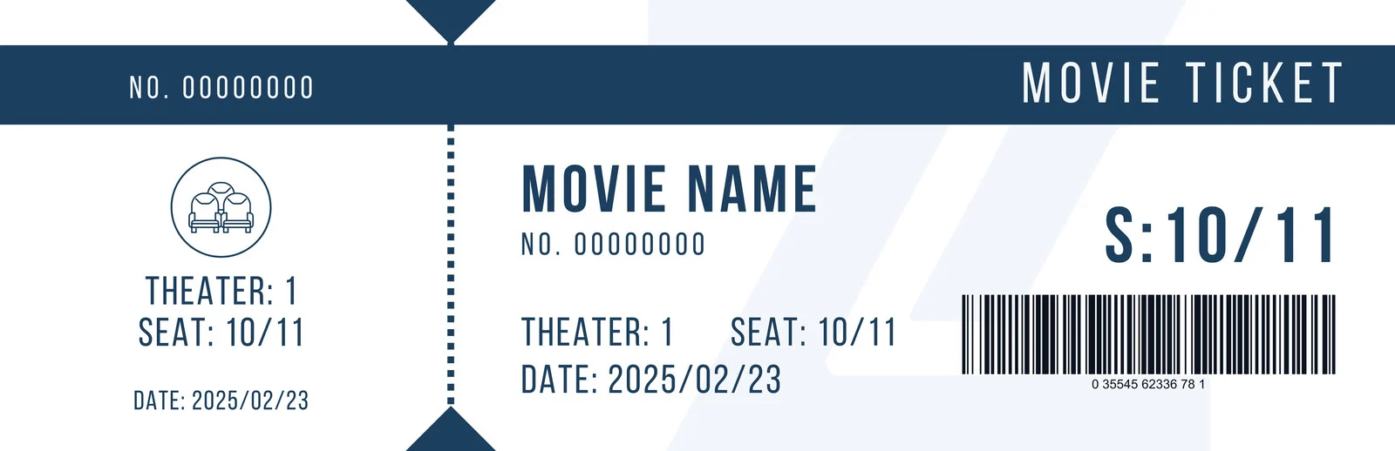
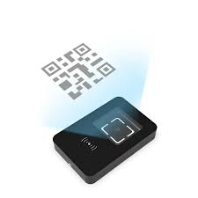
Person purchased ticket, and now they are approaching the turnstile.

Slide 19
The person scans the ticket on the scanner in front of the turnstile

Slide 20

The QR Scanner sends ticket data to the database for validation

Slide 21

The database will then detect if the ticket is valid or not and send that data back to the scanner

Slide 22

After the database’s validation, if it was a valid ticket, they are let through and if it was not valid, they are not let through

Slide 23
The ticket was valid, so the person walks through the turnstile.

Slide 24
Person has walked through the turnstile and it resets for the next person.

